Slide 1

EDR 101
Journey to bypassing EDR, from 0 to 0.1
(and how not to jump into the rabbit hole)
[24th October 2025]
[Offsec 2nd Meetup]

Slide 2
What is it?
A software or an agent that
  watches behaviors,
  spots suspicious activity (even if the file is new/unknown) and
  let the security team investigate and contain it
AV = a software that mainly blocks known bad files

Slide 3
Detection Methods
Signature/Reputation
Heuristics
Behavioral Analytics
Anomaly & ML Models
Etc..

Slide 4
Why do we need to bypass EDR?
Red team engagements
Create new detection methods/signature as precise as possible
For fun

Slide 5
Random advice from a script kiddie
Know how to read code, or at least have access to AI to explain it to you
Know how to find solutions with vast amount of knowledge available on the internet by asking the right question
If you have a mentor, it will be better and will accelerate your growth (OPTIONAL)

Slide 6
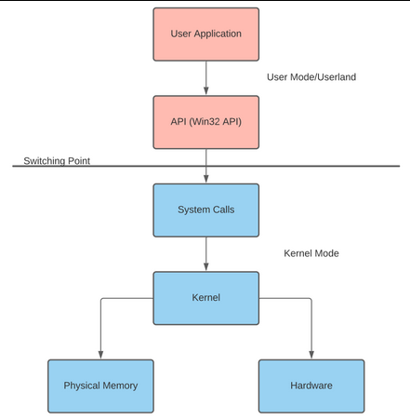
Introduction to windows API
Application Programming Interface - code required to react with OS – stored in .DLL
.h VS .dll
  header (contains declarations of functions and external variables) – eg : Windows.h
  DLL = Dynamic Link Library – not linked to program’s executable file – stub used to load the library at the runtime – eg: comdlg32.dll

Slide 7
Setting up a lab
Virtual Machines – Attacker/Target – Kali/Windows
Visual Studio Code – Write your own payload
ChatGPT – to satisfy your quench for knowledge
And an EDR that you can find (paid) or even better, for FREE!

Slide 8
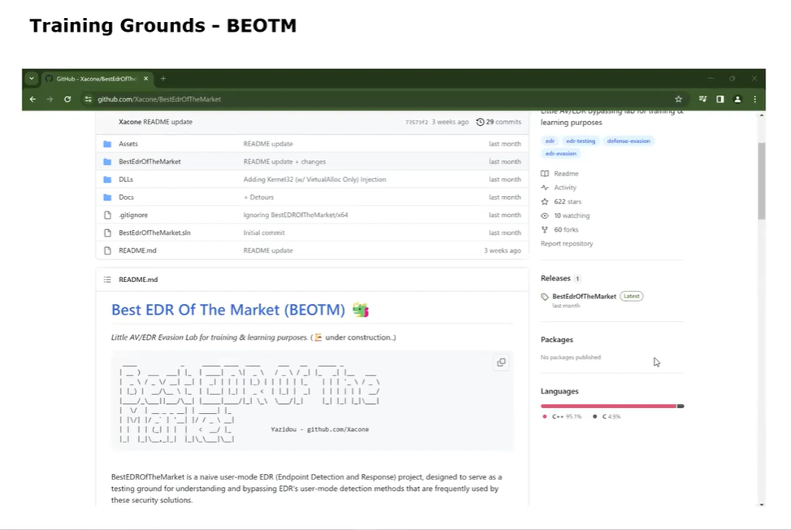
Introduction to BEOTM (old version)

Slide 9
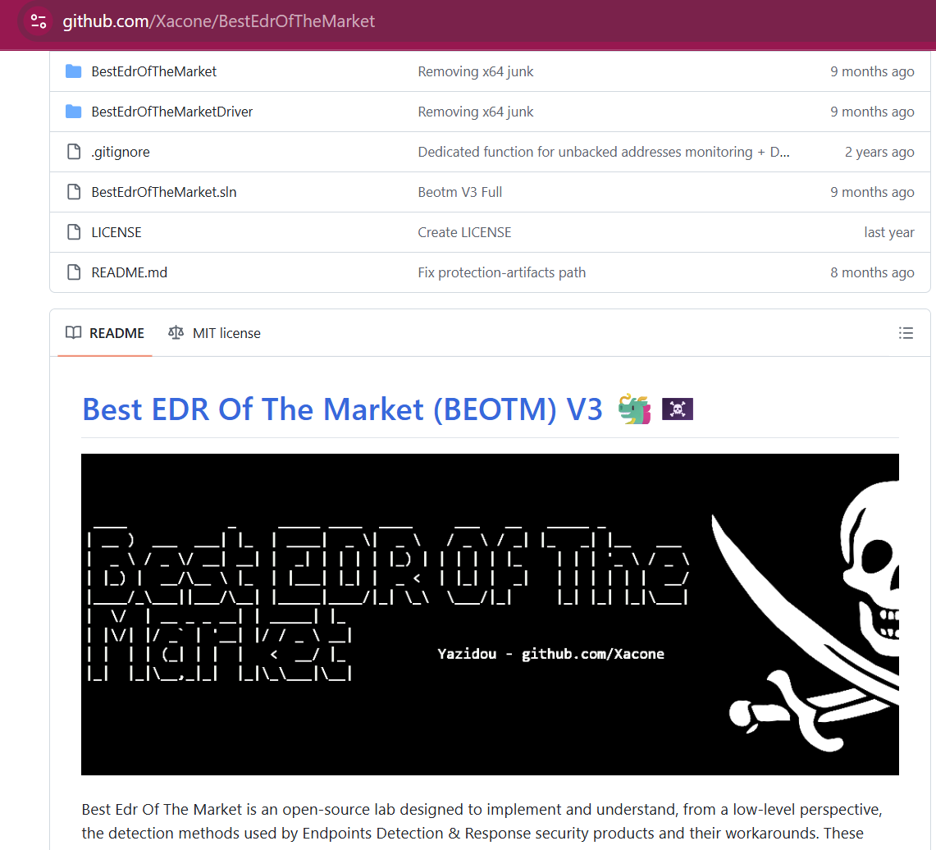
Steroid version of BEOTM (Latest)

Slide 10
What does it do?
Notes:
https://github.com/Xacone/BestEdrOfTheMarket/commit/81e7fe9ff31779cb8ea2f375f46eb04d1fa8f550 – OLD
https://github.com/Xacone/BestEdrOfTheMarket/blob/main/README.md - New

Slide 11
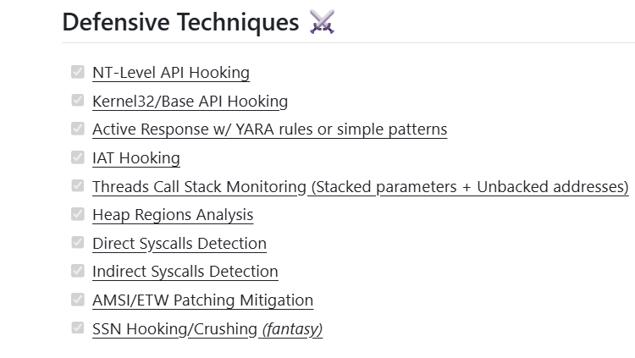

Slide 12
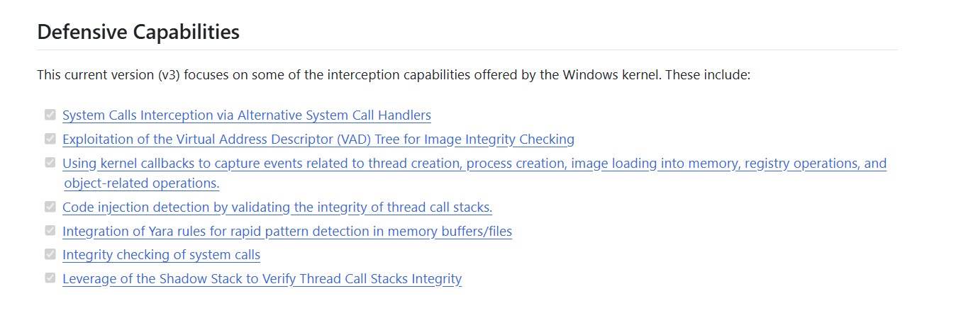
BEOTMv3

Slide 13
Introduction to Process Injection
There are 101 ways to bypass EDR, but we are interested in one technique
And this technique has 101 ways to do it
No particular reason why we pick this
Over the years, this technique has evolved as detection also becoming more and more sophisticated
Journey to bypass EDR using this one technique (maybe not today)

Slide 14

What is Process Injection
Technique used by adversaries to execute arbitrary code in the address space of separate live process
Evade detection (like a true hackerman)
Persistence
Steal Credentials
Or just, for fun!

Slide 15
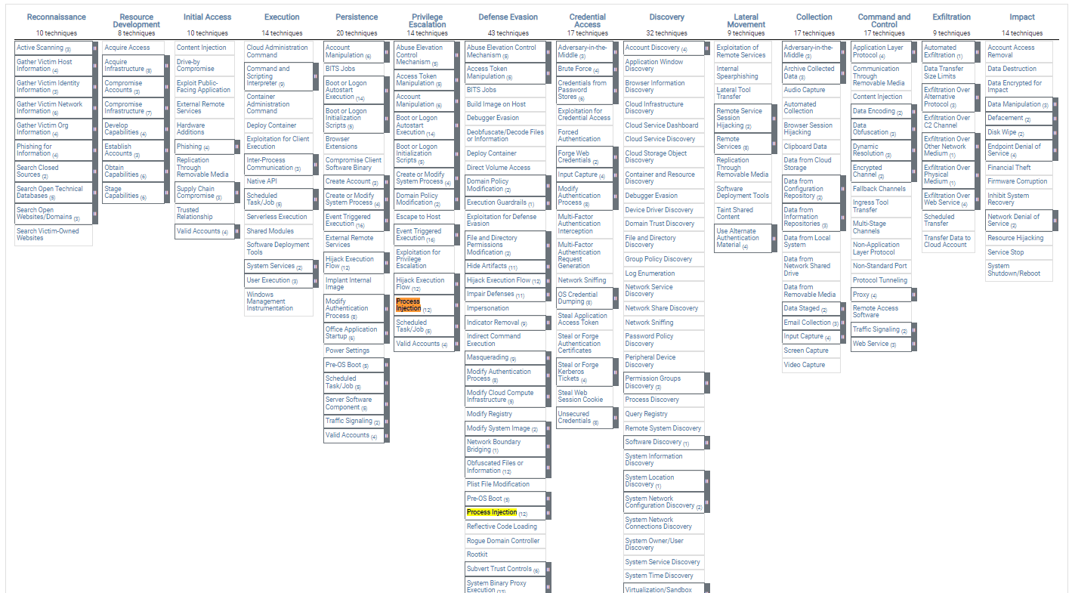

MITRE ATT&CK Framework

Slide 16
The ABC of Process Injection
get or create process
injected data
transfer to process
execution

Slide 17
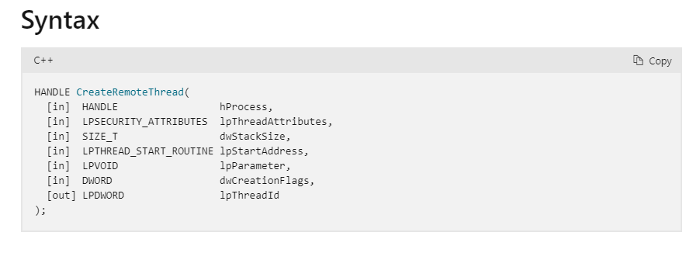
Get/Create Process
obtain handle (open / create a process)
e.g : CreateRemoteThread

Slide 18
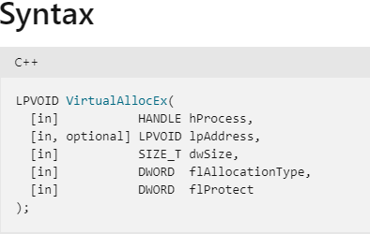
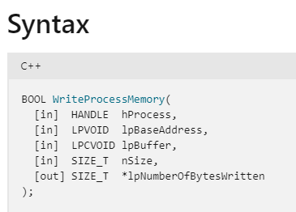
Transfer Payload to Process
ways to transfer data to target process
e.g : VirtualAllocEx,WriteProcessMemory

Slide 19
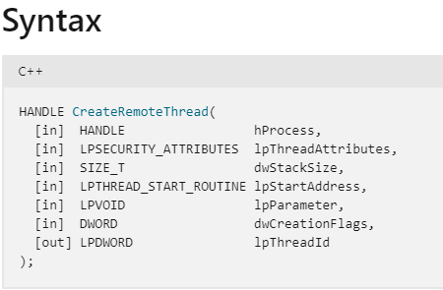
Execution
start the execution of the injected section
e.g : CreateRemoteThread

Slide 20
Proof of Concept : Vanilla Process Injection
DEMO

Slide 21
There are infinite ways to do process injection…
Doppelgänging? Early bird APC Queue? Direct/Indirect Syscall? P/Invoke? Proc Memory? D/Invoke? API Hashing? DLL Unhooking? ProcessDynamicCodePolicy? EWM injection? AtomBombing? VDSO Hijacking? ListPlanting? Ptrace Syscalls? Inline hooking? Thread Local Storage (TLS) Injection? Hell’s Gate? Kernel Driver Injection? Halo’s Gate? Tartarus Gate? PoolParty? TxF Doppelgänging? Fork Bombing? Import Table Hooking? Kernel Code Patching + APC ? etc…

Slide 22

But the technique does not matter if you don’t know why are you using it
If you just compile the code and run it
Thinking you could somehow bypass detection
Without understand how it works
Or how the detection that you want to bypass works
You are jumping into a rabbit hole
Take one step backward
And think..

Slide 23
Signature Based Detection
YARA rules
Contains combination of multiple bytes -> signature
When an EDR monitors a process, will find for the signature if they exist
If they exist, process will get interrupted/stopped -> your payload wont run

Slide 24
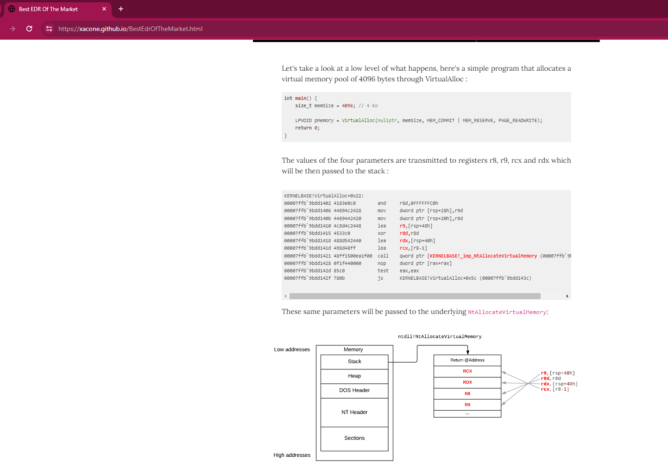
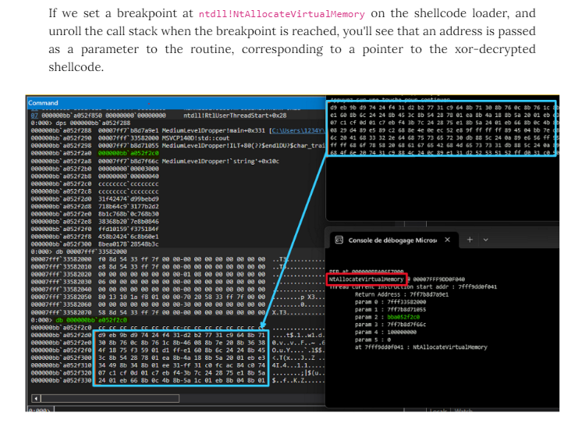

instead of jumping into the rabbit hole, why don’t we understand how this EDR works?
how?
READ THE .. MANUAL!
For example, we want to understand how threads call stack monitoring works in BEOTM;
  Continuous monitoring of the RIP instruction register for each thread.
  Pause thread if RIP points to an exported routine/function from a DLL or a specified area and check if the routine/function is listed in TriggeringFunctions.json for monitoring.
  Unwind the thread's call stack.
  Analyze parameters of stacked routines.
  Stop the process and issue an alert if a parameter's byte sequence matches a pattern in YaroRules.json.

Slide 25
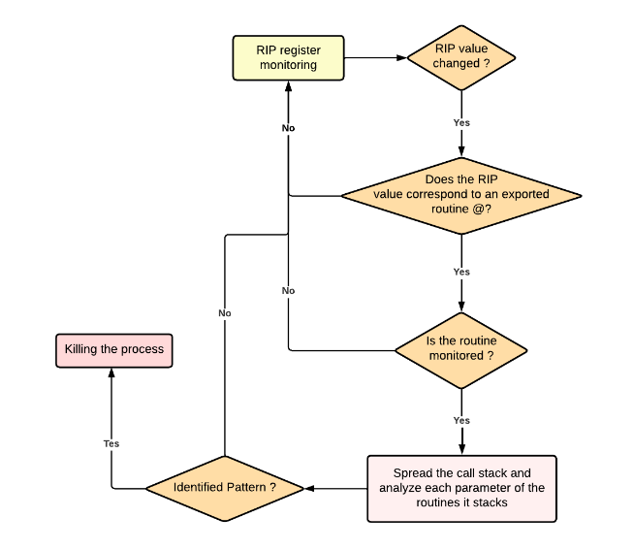
Conditional diagram on how threads call stack monitoring works on BEOTM :

Slide 26
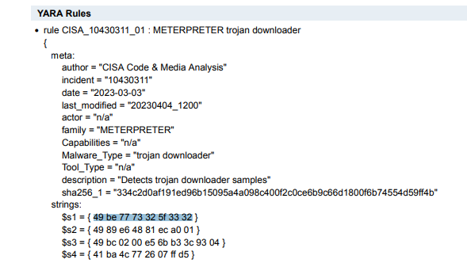

What is in TriggeringFunctions.json?
Contains functions that are hooked by the EDR.
High likely contains our vanilla process injection functions.
What is in YaroRules.json?
Contains pattern for the EDR to identify
contains default pattern for reverse_tcp shellcode generated by Metasploit

Slide 27
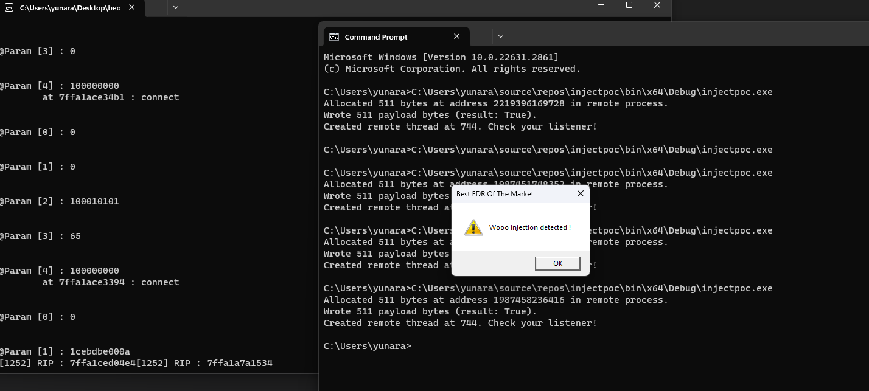
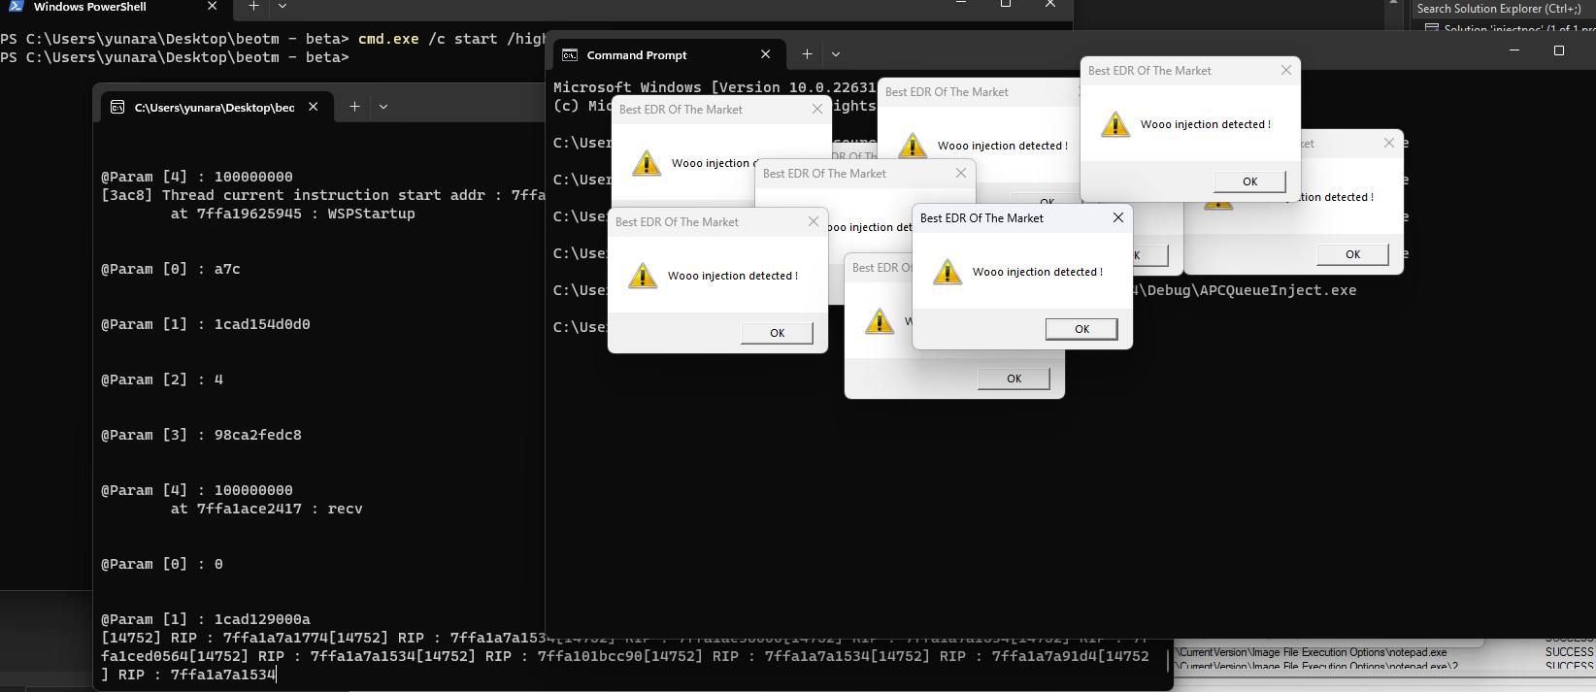
Vanilla Process Injection VS BEOTM
APC Queue VS BEOTM

Slide 28

IDEAS : Bypass BEOTM Threads Call Stack Monitoring
Use custom/different shellcode
Not generated by Metasploit
No signature/pattern in YaroRules.json
Maintain API calls (Vanilla/APC)
Bypassed?
Profit!!

Slide 29
BEOTMv3
- Demo

Slide 30
END
(for now..)

Slide 31


